Slide 1
Automating the Clustering Workflow with AI Agents
Let AI handle the prep work; you focus on the patterns. That's agentic clustering.

Slide 2






Team Overview
Kevin Abdo
Qiyi (Leo) Zhang
Nikaran K M
Yuze (Leo) Li
MMA
MMA
MMA
MMA

Slide 3
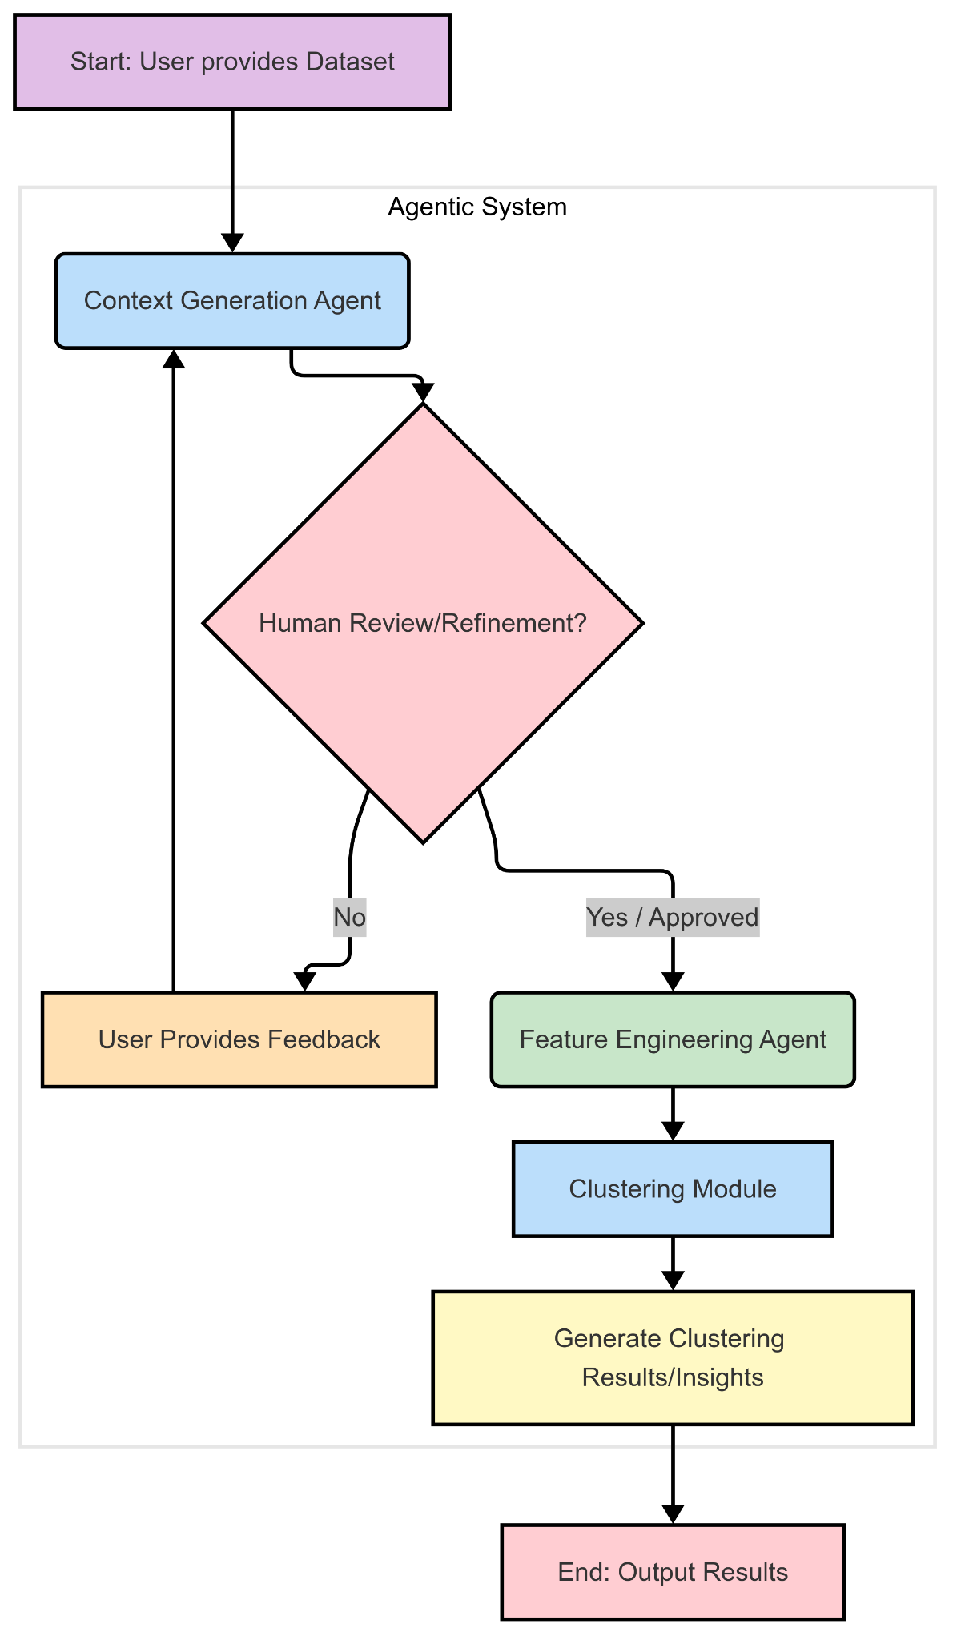
Agentic Clustering Workflow - Overview
Goal: Automate the process of data understanding, feature generation, and clustering with optional human oversight.
Input: Starts with the user providing the raw dataset.
Context Generation: An initial agent analyzes the data, performs EDA, and creates a context summary using an LLM.
Human Checkpoint 1: User can review and provide feedback to refine the context summary.
Feature Engineering: A second agent uses the context to suggest and potentially create new features relevant for clustering, guided by an LLM.
Clustering: The final dataset (with engineered features) is fed into a clustering module
Output: The system generates clustering results and insights based on the automated workflow.

Slide 4
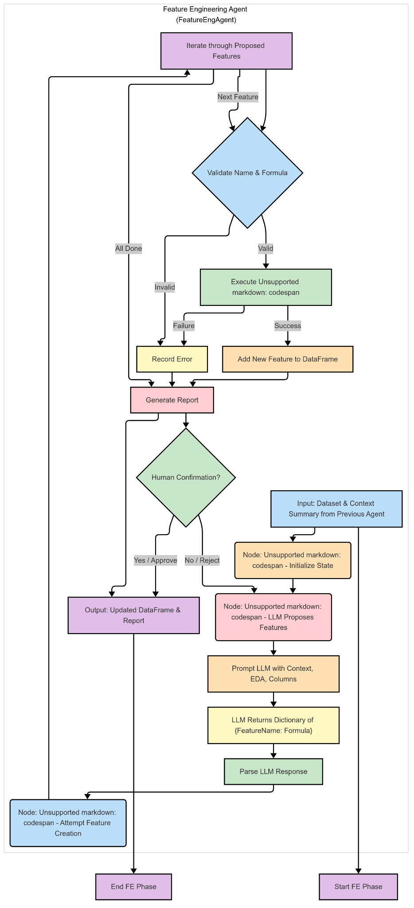
Automated Data Context Generation
Purpose: Quickly understand the input dataset's characteristics and quality.
Automated Analysis (build_data_context_from_df):
Performs standard EDA (stats, missing data, value counts).
Generates key visualizations (histograms, count plots, correlation heatmap).
Learns a lower-dimensional data representation (PCA) and visualizes it (t-SNE) to hint at structure.
LLM Synthesis: An LLM analyzes all generated text and visual information to create a comprehensive, natural language context summary.
Human-in-the-Loop (DescriptionAgent):
Presents the initial LLM-generated description to the user.
Allows the user to approve the description or provide specific feedback for refinement.
If feedback is given, the LLM refines the description accordingly, iterating until the user approves.
Output: A validated, AI-assisted data context summary and the agent's final state.

Slide 5
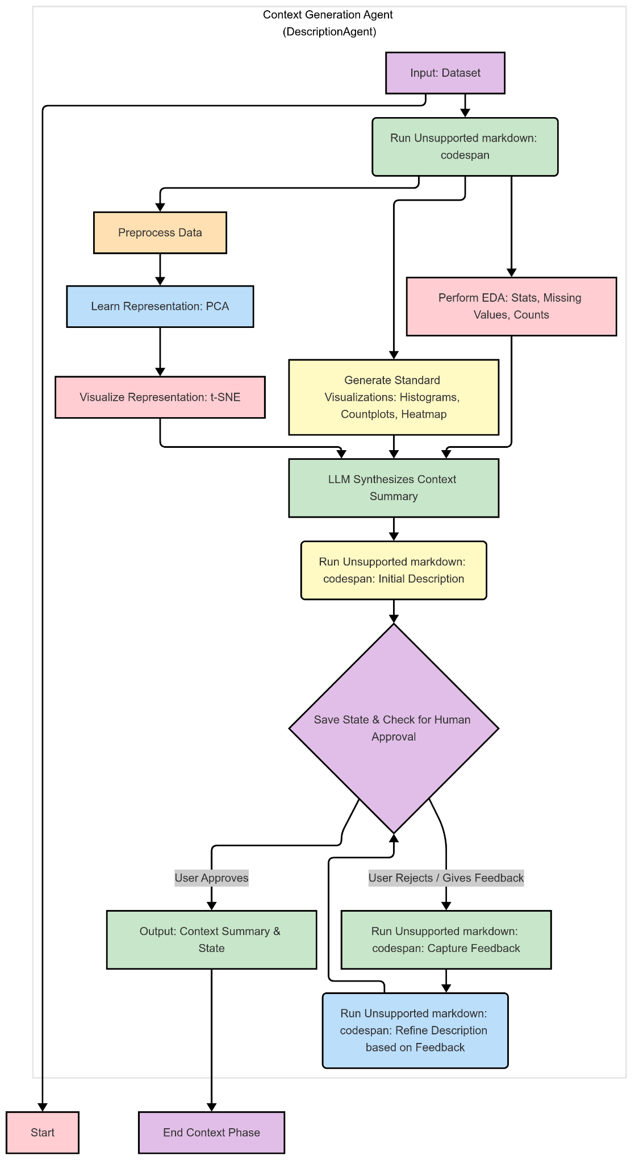
AI-Assisted Feature Engineering
Purpose: Accelerate feature ideation and creation by leveraging AI based on data context.
Input: Takes the validated context summary and the (original or potentially already refined) dataset.
Feature Proposal (selectfeature node):
Prompts an LLM with the context, EDA summary, and existing column names.
LLM suggests 3-5 potentially useful new features (e.g., interactions, ratios) specifically relevant for clustering.
LLM provides feature names and Python formulas compatible with pandas eval.
Feature Creation (engfeature node):
The agent parses the LLM's suggestions.
It attempts to execute the formulas using df.eval() to create the new features in the DataFrame.
Reports on which features were successfully created and which failed (e.g., due to formula errors).
Output: An updated DataFrame enriched with new, AI-suggested features, ready for the clustering module.

Slide 6
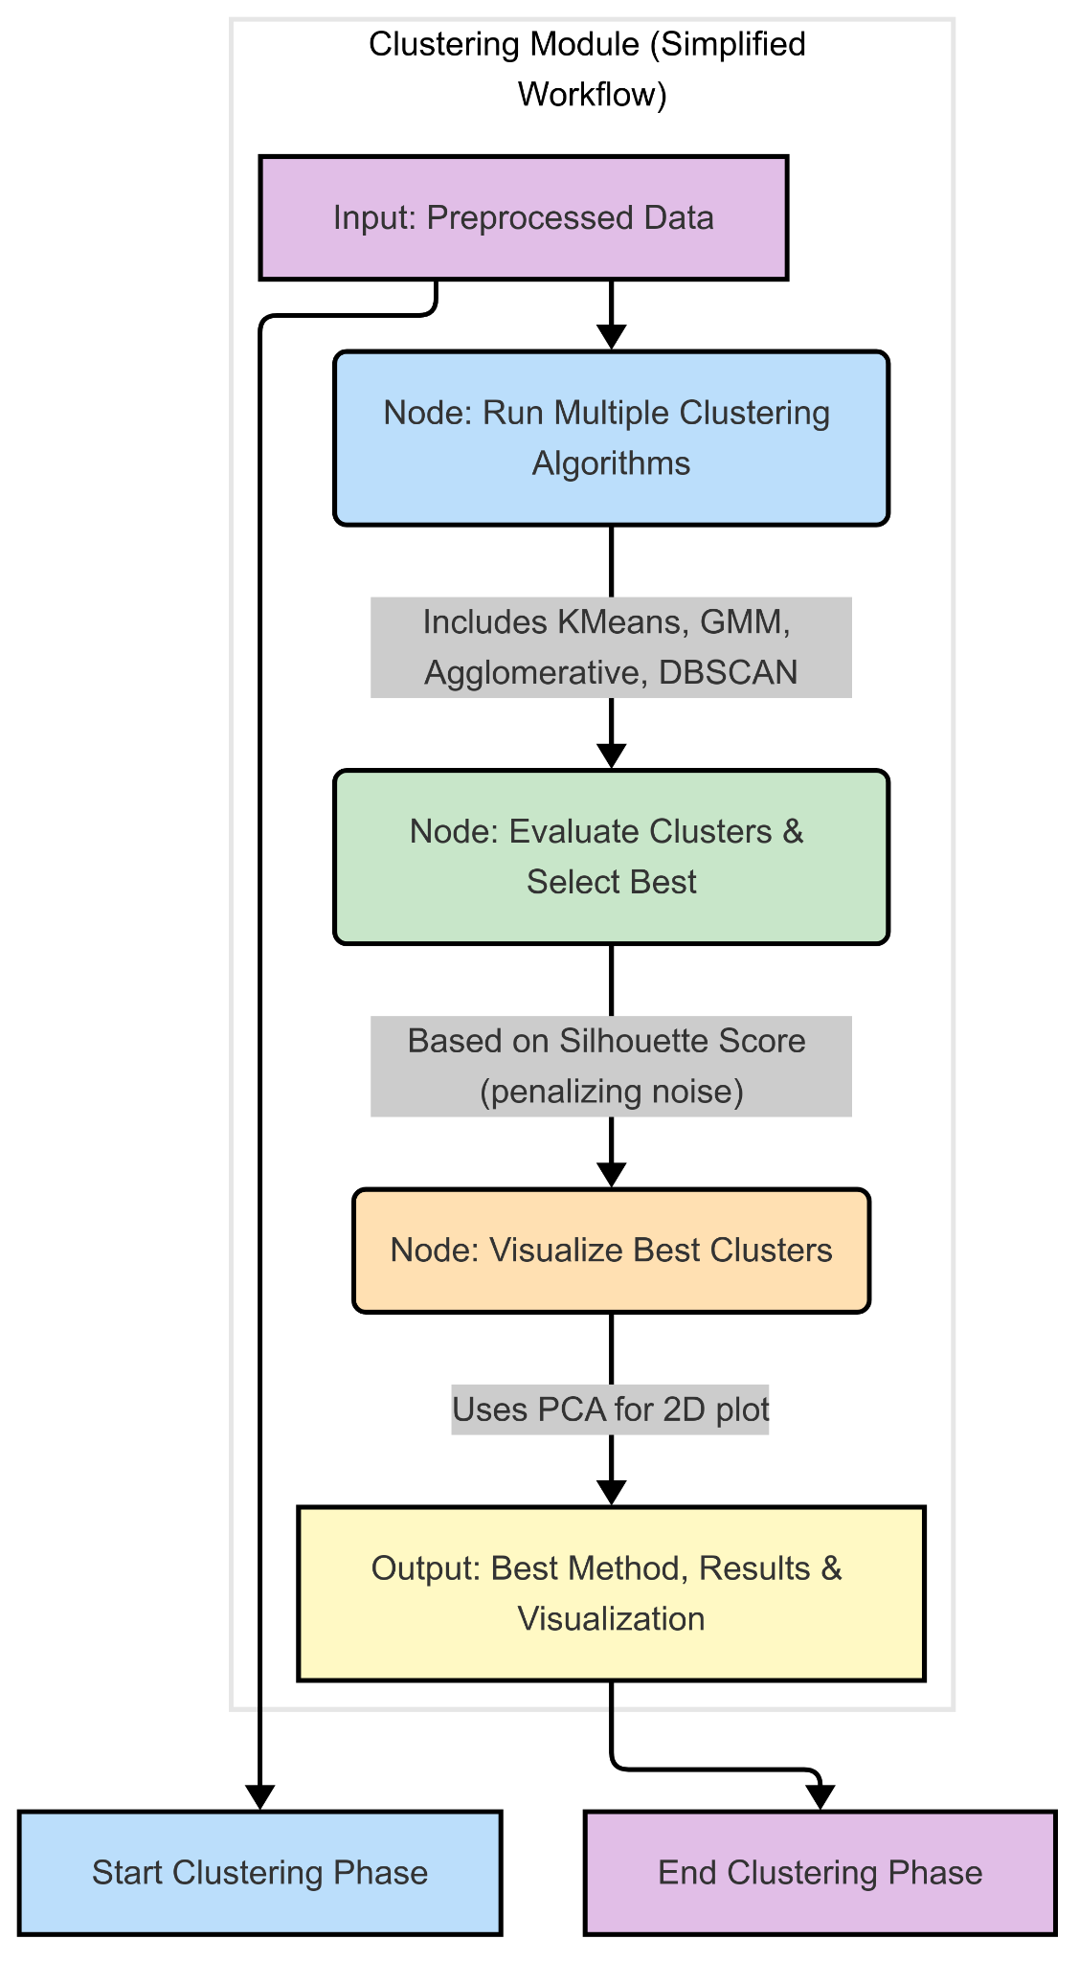
Clustering Module: Generating Insights
Purpose: Apply multiple clustering algorithms to the preprocessed data, evaluate their performance, and select the best approach.
Input: Takes the preprocessed (scaled, encoded) data from the previous steps.
Algorithm Execution: Systematically runs and tunes (where applicable) several standard clustering algorithms:
K-Means (testing K from 2 to 10).
Gaussian Mixture Models (testing components from 2 to 10).
Agglomerative Clustering (using the optimal K found by K-Means).
DBSCAN (using default parameters like eps=0.5, min_samples=5).
Evaluation: Calculates the Silhouette Score for each method to quantify cluster separation and cohesion. For DBSCAN, the score is calculated only on non-noise points.
Best Method Selection: Compares the valid Silhouette Scores, automatically identifying the best-performing algorithm. DBSCAN results are penalized (not considered "best") if the noise ratio exceeds 50%.
Visualization: Reduces the dimensionality of the data using PCA and generates a scatter plot visualizing the clusters found by the best selected method.
Output: Provides the name of the best method, the corresponding cluster labels, evaluation metrics (scores, noise ratio), parameters used, and the cluster visualization.

Slide 7
Demo

Slide 8
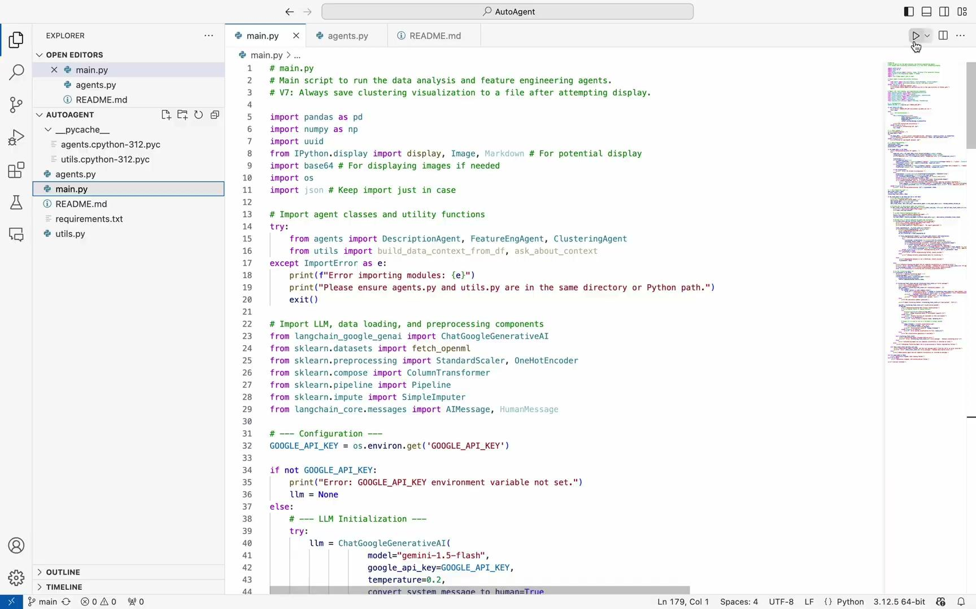

Slide 9
